Slide 1

Log File Analysis and Reporting System
CHENNAMANENI NAVEEN KUMAR RAO

Slide 2

Introduction: The Power of Log Data
The Log File Analysis and Reporting System is designed to extract meaningful insights from raw server log files. It automates the process of collecting, parsing, storing, and analyzing log data using a stack built with Python, MySQL, Flask, Pandas, and Plotly.
The system provides:
A web-based dashboard for visual analytics.
A CLI interface for generating on-demand reports.
Analysis of top endpoints, HTTP status codes, IP traffic patterns, and error rates.

Slide 3




Abstract: Unlocking Hidden Value
Data Ingestion
Actionable Visualization
Intelligent Processing
This project presents a comprehensive Log File Analysis and Reporting System designed to convert raw HTTP log data into insightful visual dashboards and tabular CLI reports.
Using technologies like Python, MySQL, Flask, SQLAlchemy, Pandas, and Plotly, the system delivers both interactive dashboards and command-line summaries to serve diverse use cases.
The Log File Analysis and Reporting System is a full-stack analytical solution developed to extract, process, and visualize meaningful insights from raw HTTP server log files.

Slide 4
Problem Statement: The Challenge of Unstructured Data
Large organizations and websites deal with thousands of log entries daily.
However:
There's no easy way to quickly understand what’s happening across logs.
Manual scanning is tedious, error-prone, and reactive rather than proactive.
Existing tools may be costly or complex for small teams.
Hence, there's a need for an efficient log analysis solution that can:
1)Detect errors and anomalies,
2)Visualize user behavior,

Slide 5




Objectives: Structured Insights for Strategic Action
Automate Ingestion & Parsing
Structured Data Storage
Streamline the collection and structuring of diverse server log formats.
Normalize and store log data in a robust relational database (MySQL).
Real-time Reporting
Interactive Visualizations
Provide on-demand insights via both CLI and an intuitive web dashboard.
Enable dynamic exploration of key metrics like top IPs, endpoint analysis, and error rates.

Slide 6

Methodology: From Raw Logs to Rich Visuals
Log Parsing
Data Storage
Analysis:
Visualization
Our methodology ensures a seamless flow from raw data to actionable insights:
Log Parsing: Utilizing Regex for efficient extraction from Apache/Nginx logs.
Data Storage: Normalized schema in MySQL ensures data integrity and query efficiency.
Analysis: Pandas and SQL queries drive robust data aggregation.
Visualization: Plotly and Dash integrate with Flask for interactive dashboards and CLI textual summaries.

Slide 7
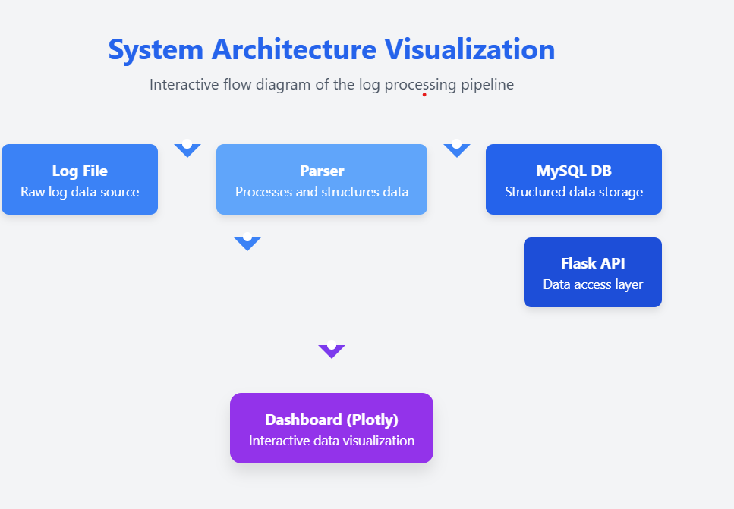
System Architecture Visualization

Slide 8
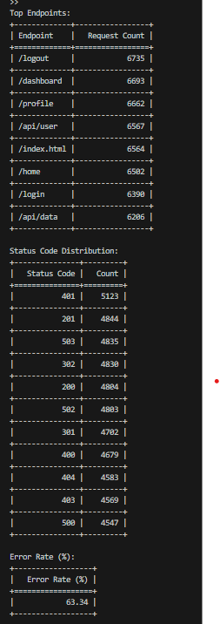
Key Features: Comprehensive Reporting & Monitoring
Intuitive Dashboard
Flexible Reporting
Status code distribution (pie chart)
CLI reports for quick summaries (Top IPs, error logs, traffic).
Hourly/daily traffic trends (line chart)
MySQL schema designed for scalable log and user-agent data.
Top requested endpoints & IPs (bar charts)

Slide 9
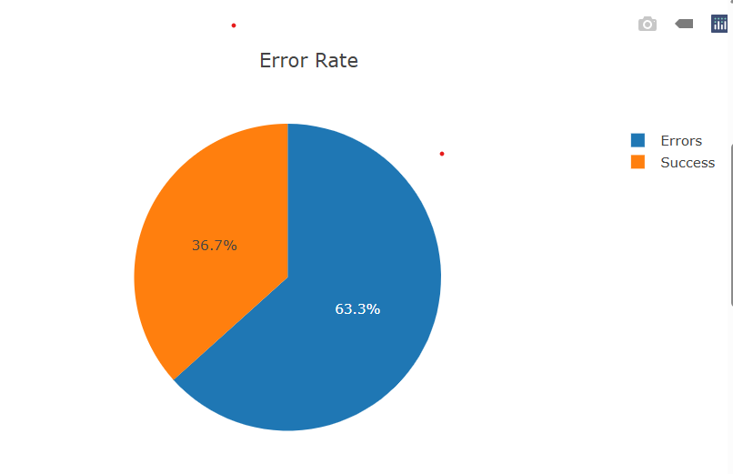
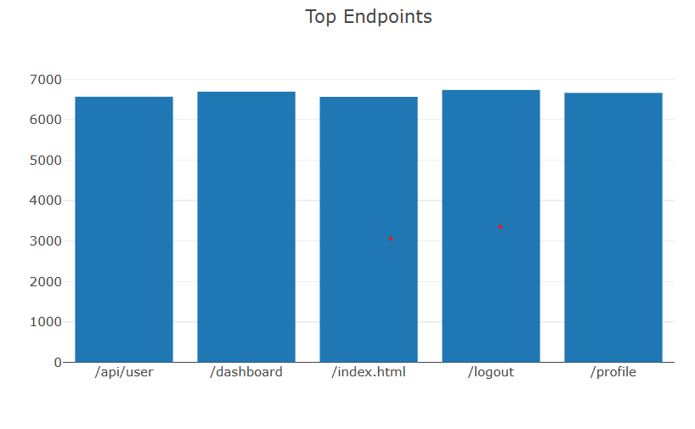
Sample Visualizations: Transforming Data into Graphics
200 OK
301 Redirect
404 Not Found
500 Server Error
Illustrates the Pie Chart of Error Rate , highlighting error rates of Errors and Success
Depicts Top Endpoints, identifying peak endpoints.
These visualizations provide immediate understanding of Error Rate and Endpoints.

Slide 10

Conclusion: Actionable Intelligence from Raw Data
This project successfully bridges the gap between raw, unstructured log data and meaningful, decision-making insights. By providing a dual interface (CLI and Web Dashboard), the system offers scalable analysis capabilities, empowering technical supervisors and stakeholders to monitor system health, web traffic, and security posture in near real-time.

Slide 11
Future Scope: Enhancing the Analysis Frontier
Machine Learning Integration Automate anomaly detection and pattern recognition in log data using ML models to proactively alert for threats and issues.
Multi-source Aggregation Expand support for collecting logs from multiple systems (e.g., Nginx, AWS CloudWatch, Windows Event Logs) for centralized analysis.
Role-based Access & Secure Sharing Implement user authentication and authorization for secure, multi-user access to reports and visualizations.
Scalable Cloud Deployment Deploy the system on cloud platforms (AWS/GCP/Azure) using containerization (Docker) and orchestration (Kubernetes) for scalability.

Slide 12
THANK YOU

